Slide 1

An Analysis of NoSQL Database Systems with Regards to Strengths, Weaknesses and Utility
COS 326
[2016/09/13]
6
Topic:
Group:
Members:
Panda Chicken
Natasha Schoeman
u14009562
Emilio Singh
u14006512
Renton McIntyre
u14312710
Avinash Singh
u14043778
Jason Gordon
u14405025
Claudio Da Silva
u14205892

Slide 2
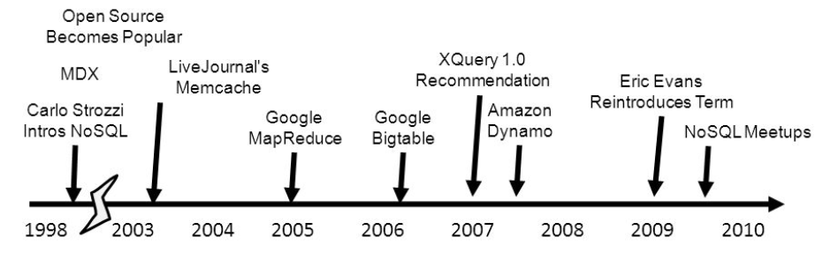
Introduction
In Neil Leavitt's article he presented a question whether NoSQL databases will live up to their promise.
We had then done extensive research in this field and looked at information dating after 2010 to get the most relevant and accurate data.

Slide 3
NoSQL vs SQL
SQL:
Not easily distributable or scalable over a variety of machines/networks
Heavily reliant on structured data so that it conforms easily into tables
NOSQL:
Uses key-value and document-based storage
Thus it is not heavily reliant on structure (as SQL is)
Very scalable making it a good choice for data-fluid companies

Slide 4
NoSQL vs SQL
SQL:
Makes use of expensive JOINS to process complex data
Struggles with processing large amounts of data
NOSQL:
Indexes commonly used data, thus faster access to data and faster processing of data
Was created to handle large amounts of data (Big data)

Slide 5
Drawbacks of NOSQL
Lack of reliability, due to more efficient processing
Increased complexity
Increased cost for companies already using SQL-based systems

Slide 6

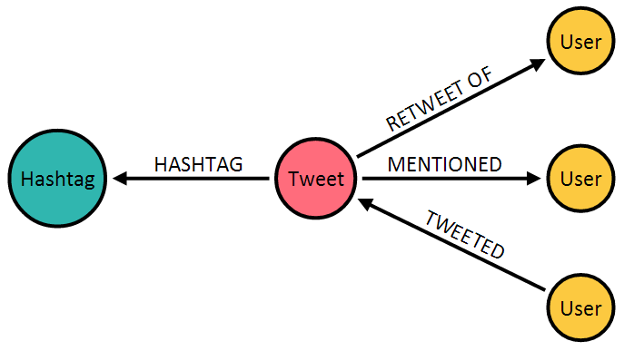

Relevance to COS326
It is important to know the benefits and drawbacks of each NOSQL database that we have been taught
Document-based databases such as MongoDB are more typically used in industry as it is easy to interface with and very powerful
Graphing databases such as Neo4j provide good visualization of data which is best suited for social networks.

Slide 7
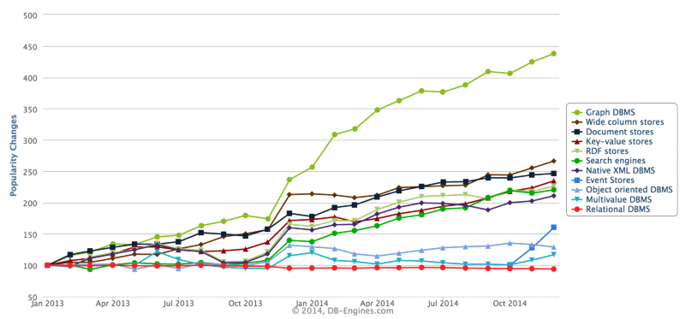

Slide 8
Conclusion
The main advantages of NoSQL databases are that they are easily scalable and well suited for unstructured data
They are also very efficient when working with large amounts of data, without any loss of functionality
Although they are relatively complex to use and schema changes are difficult, the advantages of NOSQL outweigh these drawbacks
NOSQL databases have a growing market due to the fact that Big Data is commonly used in many companies today and will be used in the future

Slide 9
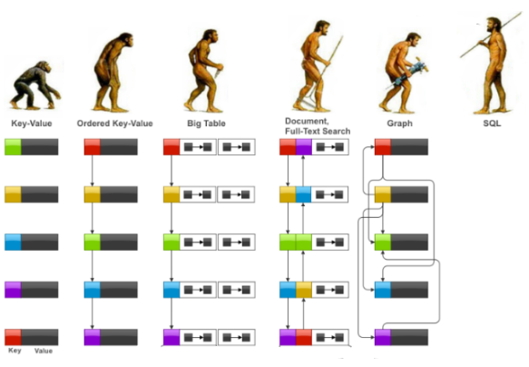
The End

